Slide 1

How often…? Frequency expressions
8B
Study Habits

Slide 2
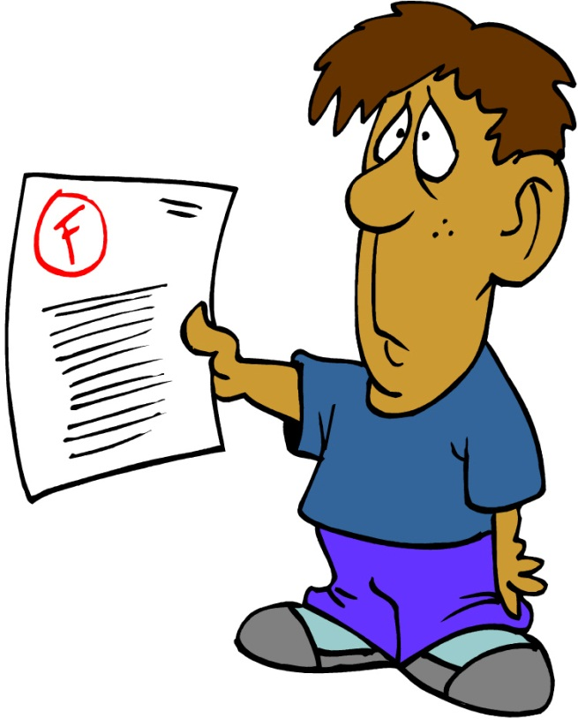
Study Habits
Well, I always do my homework, and I often ask the teacher for help.
Hmmm… Well, I am usually late for class, and I never do my homework.
Maybe I need to try your study habits.
You got an “A+” again!?!? How do you do it?
Oh, I got an “A+.”
I got an “F” again.

Slide 3
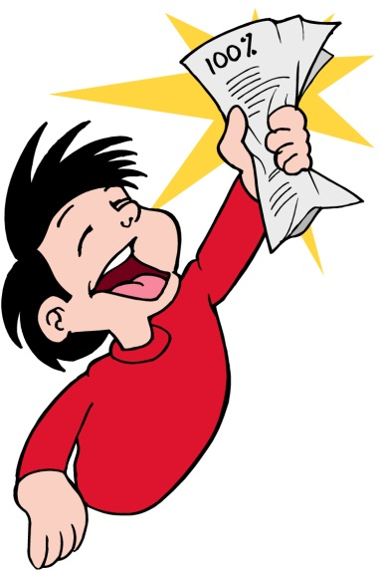
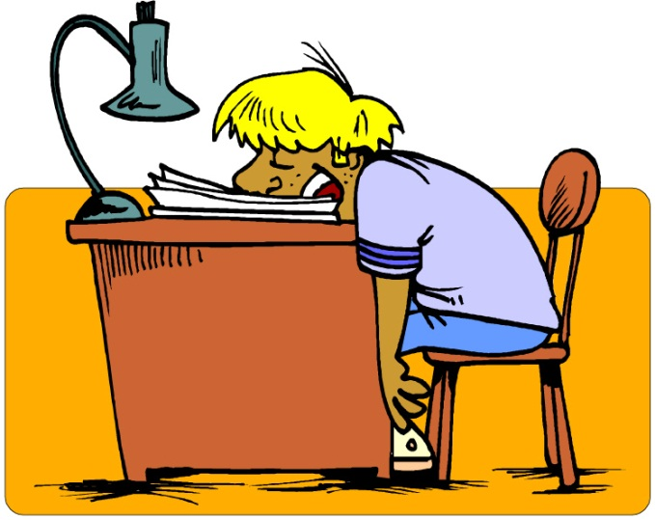
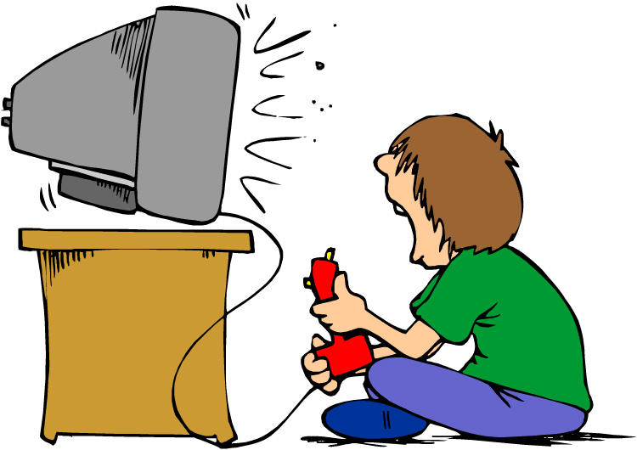
Adverbs of Frequency 1
How often does he study?
How often is he in front of the TV ?
100%
always
usually
often
sometimes
50%
He always studies.
He rarely studies.
rarely
usually
He sometimes studies.
never
never
often
0%

Slide 4
Every day
_________ , Sasha feeds her dog.
Every day
Every other day
Once a week
Twice a week
Three times a week
Several times a week
All the time
Once in a while
Hardly ever
Sun
Mon
Tues
Wed
Thurs
Fri
Sat
√
√
√
√
√
√
√

Slide 5
Jara watches T.V._____________.
every other day
Every day
Every other day
Once a week
Twice a week
Three times a week
Several times a week
All the time
Once in a while
Hardly ever
Sun
Mon
Tues
Wed
Thurs
Fri
Sat
√
√
√

Slide 6
Jara watches T.V._________________.
three times a week
Every day
Every other day
Once a week
Twice a week
Three times a week
Several times a week
All the time
Once in a while
Hardly ever
Sun
Mon
Tues
Wed
Thurs
Fri
Sat
√
√
√
Sun
Mon
Tues
Wed
Thurs
Fri
Sat
√
√
√

Slide 7
Luke cooks dinner _______________.
once a week
Every day
Every other day
Once a week
Twice a week
Three times a week
Several times a week
All the time
Once in a while
Hardly ever
Sun
Mon
Tues
Wed
Thurs
Fri
Sat
√

Slide 8
Luke cooks dinner ______________.
twice a week
Every day
Every other day
Once a week
Twice a week
Three times a week
Several times a week
All the time
Once in a while
Hardly ever
Sun
Mon
Tues
Wed
Thurs
Fri
Sat
√
√

Slide 9
Every day
_________ , Sasha feeds her dog.
Every day
Every other day
Once a week
Twice a week
Three times a week
Several times a week
All the time
Once in a while
Hardly ever
Sun
Mon
Tues
Wed
Thurs
Fri
Sat
√
√
√
√
√
√

Slide 10
once in while
Sasha exercises ______________.
Every day
Every other day
Once a week
Twice a week
Three times a week
Several times a week
All the time
Once in a while
Hardly ever
Sun
Mon
Tues
Wed
Thurs
Fri
Sat
Sun
Mon
Tues
Wed
Thurs
Fri
Sat
√
√
Sun
Mon
Tues
Wed
Thurs
Fri
Sat
Sun
Mon
Tues
Wed
Thurs
Fri
Sat
√

Slide 11
once in while
Sasha exercises ______________.
Every day
Every other day
Once a week
Twice a week
Three times a week
Several times a week
All the time
Once in a while
Hardly ever
Sun
Mon
Tues
Wed
Thurs
Fri
Sat
√
Sun
Mon
Tues
Wed
Thurs
Fri
Sat
√
√
Sun
Mon
Tues
Wed
Thurs
Fri
Sat
√
Sun
Mon
Tues
Wed
Thurs
Fri
Sat
√
√
√

Slide 12
hardly ever
Sasha __________ eats chocolate.
Every day
Every other day
Once a week
Twice a week
Three times a week
Several times a week
All the time
Once in a while
Hardly ever
Sun
Mon
Tues
Wed
Thurs
Fri
Sat
Sun
Mon
Tues
Wed
Thurs
Fri
Sat
√
Sun
Mon
Tues
Wed
Thurs
Fri
Sat
Sun
Mon
Tues
Wed
Thurs
Fri
Sat
√

Slide 13
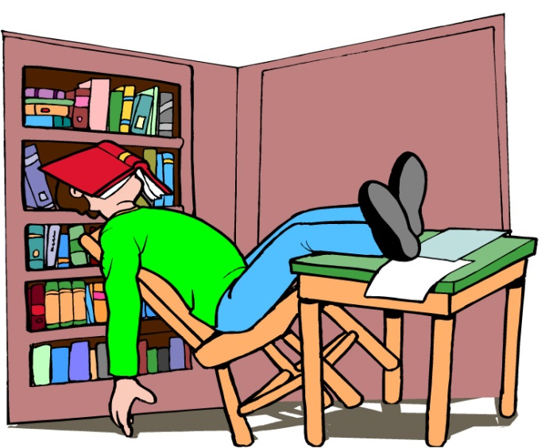

Practice 2
With a partner, ask questions with how often. Follow the examples.
How often _______ you…
Example:
fall asleep studying
be tired
study in a group
be bored in class
listen to the teacher
practice speaking English
get an “A” on a test
be confused in class
How often do you fall asleep studying?
How often are you tired?

